Slide 1
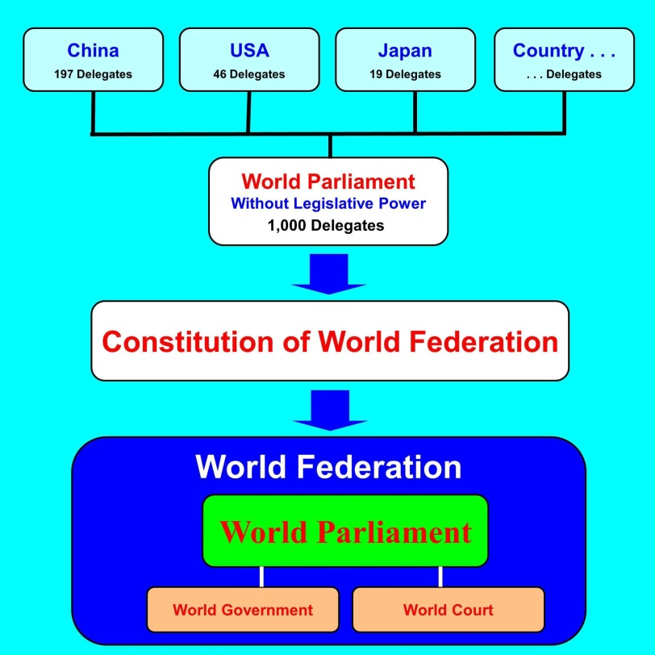
Political Party of World Citizen
Japanese Branch of World Party
World Party Japan
International Party to Establish the World Federation
In the World Federation, there are benefits shown on the right.
1. World Federation can reduce or prevent the war, and so the destruction by war is reduced or prevented.
2. World Federation can reduce the military expenditure.
3. Fluctuation of exchange rate will be removed because the World Central Bank will issue the international common currency.
World Federation is established as shown in the figure on the left.
Delegates are sent from each country to the World Parliament in proportion to population. Even if only 2 countries send the delegates, it can form a part of the World Parliament and other countries can join later. Like this, a part of the World Parliament can develop to the whole World Parliament.
The World Parliaments on the early stage is a consultative assembly without the legislative power. If the World Parliament functions well, the legislative power is vested with by the attending countries, and the World Parliament establishes the Constitution of World Federation. In the World Federation, the system is not the division of three powers, the legislation, the administration, and the judicature. The World Parliament is the supreme authority of the World Federation. The World Parliament elects the Prime Minister of the World Government and the judges of the World Court.
Important feature of the World Parliament is that
each country may register delegates up to 3 times as may as the seats and the registered delegates (Hereafter,
registered member) may object to the membership of other registered members. If the objections reach 5% of the total votes of registered members, the motion to dismiss the member is made at the World Parliament. If the attending delegates with more than 50% of total votes of the attending delegates object to the motion, the objected registered member is not dismissed. Therefore, if the motion is not rejected, the objected member is dismissed even if the objections are only 5% of the total votes of the registered members. For example, even if 3,000 delegates are registered, registered members may be reduced to 10 due to objection. Even so, the 10 members will become the definite authority and get the support of people. So, the World Parliament will be the supreme authority in the World Federation.
World Party was founded aiming to be the party existing 1,000 years later.

Slide 2
Three principles of World Party are as follows.
1. The top priority is the benefits of world as a whole or the benefits of society as a whole. Benefits of party come after that. If the world becomes better, our country will become better. If our country becomes better, our life will become better.
2. There must not be lie with regard to the policy of the World Party.
3. There must not be corruption in the World Party. We must be strict with regard to fund.
As written in the three principles, if the world becomes better, our life will become better. For example, we need not have the nuclear weapons if the World Federation is established. So, we need not maintain the nuclear power station to maintain the technology of nuclear weapons.
Furthermore, if there is a peaceful way to solve territorial issues such as Senkaku Islets, Takejima Island, and Northern Territory that are serious recently, the only peaceful way possible seems to be the dialogue in the World Parliament.
As written in the three principles, there is no lie in the policy of the World Party. For example, a system that can dismiss inappropriate members, like the registered members of the World Parliament, is stipulated in the World Party Statute. So, there is no corruption in the World Party. In the World Party Convention in Ghana in 2011, a member who insisted that he holds the doctorate but did not send a copy of certificate was dismissed.
Traditional Politics and Future Politics of Japan
Traditional Politics
While there are many problems in the world, there are many problems in Japan also. In nowadays when serious problems of modern society of Japan are more and more getting worse, we must understand the good aspect and the bad aspect of traditional politics of Japan and think of the desirable future politics of Japan.
Traditional politics of Japan can be said, in a word, “The politics of Bushi (Samurai, ancient warrior in Japan)”. As the famous phrase “The way of Bushi is to die,” says, Bushi ruled over people with the power of spirit of fighting at the risk of their life when it is necessary. Seppuku or Harakiri (a ritual in which Bushi stab belly by sword and commit suicide to take responsibility) is famous in the world. On the other hand, Bushi made their livelihood by collecting tribute from farmers. There was a serious problem in the finance of the society ruled by Bushi. Economy of Japan went bankrupt many times since the Kamakura Period (1192-1333). In Kamakura Period, Kamakura Shogunate (Japan‘s feudal government at Kamakura) issued Tokuseirei (an order of cancelling debts) in 1297, and 36 years later in 1333, the Shogunate collapsed. In Muromachi Period (1336-1467), Shashaku (people engaged in transport business by renting wagons), Bashaku (people engaged in transport business by renting horses), and farmers got the Tokuseirei from the Muromachi Shogunate (Japan’s feudal government at Muromachi, Kyoto) in 1441. Twenty-six years later, the Ōnin War broke out in 1467 and the country entered into the Warring States Period (1467-1590). In this age, Japan was in the anarchy for more than 100 years, and each country fought to unify Japan. In the Edo Period (1603-1867), Tadakuni Mizuno of Edo Shogunate (Japan‘s feudal government at Edo (present: Tokyo)) who implemented the Tenpo Reform from 1841 issued the Kienrei (an order of cancelling debts) and exempted a part of debts of Hatamoto and Gokenin (direct and low-grade retainers of Shogun who was the commander-in-chief of an expeditionary force against the barbarians and was the head of the Shogunate), and tried to extract a huge amount of government funds from merchants. These government funds were, as it were, forced public bonds because they were to be redeemed with interest. Furthermore, he issued a great amount of money by lowering the quality, and so the inflation occurred. And 26 years later, the Shogunate collapsed in 1867. Considering like this, we can see that the present age resembles very well the age when a regime collapsed and a new regime emerged. Namely, in the present age, the deficit of the national finance is swelling, and the state is going bankrupt. It is said that the debt of state is 200% of GDP. The Abe Cabinet, that started in 2012, is trying to take an easy-money policy. The policy is not essentially different from the Tenpo Reform in the Edo Period, and the result is clear. In Kamakura Period, Muromachi Period, and Edo Period, Shogun was appointed by Emperor and ruled Japan, and in these period, the Tokuseirei or the Kienrei were issued. Emperor is hereditary and so people around the Emperor was also hereditary, and this made the state go bankrupt. In the present age, government is Shogunate, and the national bankruptcy similar to that in the feudal age is going to happen. This is the traditional politics of Japan.
The mechanism of regime collapse can be explained as follows. Sometime Emperor itself ruled a country or sometime customarily appointed the ruler. Thus, while Emperor System itself has continued, the ruler of country has changed many times under the Emperor. The reason why some regimes have repeated the rise and fall is that the Emperor System is a

Slide 3
hereditary system. The Emperor is hereditary and so the privileged classes around the Emperor are also hereditary. For example, at the Edo Shogunate also, Shogun was appointed by Emperor. But there emerges a gap between the privileged classes such as Emperor, Shogun, Hatamoto and Gokenin, Daimyo (feudal lord) and other people because the privileged classes are hereditary. The Shogunate promoted the purge of outside Daimyo (Daimyo who was not a hereditary retainer of the Tokugawa clan who were the head of the Edo Shogunate) and, on the other hand, favored Hatamoto and Gokenin in order to maintain the regime. Inevitably, the finance of Shogunate becomes tight. The Shogunate issued the Kienrei or recast coins and boosted the volume in order to compensate the deficit. Thus, in this process, the complaint of people accumulated and the Shogunate collapsed. This can be said for the Kamakura Shogunate and the Muromachi Shogunate before the Edo Shogunate also. Needless to say, in the present age, the government corresponds to the Shogunate. Although Japanese economy is in recession, financial assets of people are more than 2 times as large as the GDP and Japan is the top class creditor nation in the world. So, the financial deficit is the responsibility of the government. Whether it is the Shogunate or the government, this is repeated as far as the man of power rules a country by revering the Emperor. Namely, it is the state slavery.
When we think of traditional politics of Japan, we must consider the politics of Japan at the time of World War II that constitutes another aspect. Here, we need to review the history of prewar period when there was no foreign troop in Japan.
The following is an outline of history of modern Japan.
1853 Commodore Perry came to Uraga (a town near Tokyo). Next year, US-Japan Peace Treaty was concluded.
1861 Civil War in USA.
1867 Restoration of Imperial Rule. The fall of Edo Shogunate (Japan's feudal government at Edo (present: Tokyo)).
1874 Dispatch of troops to Taiwan.
1889 Promulgation of the Constitution of Great Japanese Empire. Establishment of prewar Emperor System.
1894 Sino-Japanese War.
1904 Russo-Japanese War.
1910 Annexation of Korea.
1914 World War I.
1920 Entry into the League of Nations.
1931 Manchurian Incident.
1932 5.15 Incident. Prime Minister Tsuyoshi Inukai was murdered.
1933 Withdrawal from the League of Nations.
1936 2.26 Incident. Finance Minister Korekiyo Takahashi and others were murdered.
1939 World War II.
1941 In November, USA presented the Hull=Note that required concessions such as the withdrawal of Japan from China and Vietnam. In December, the Pacific War.
1945 The end of the war. Next year, announcement of the Constitution of Japan. Emperor became the symbol of Japan.
Like this, until the US Commodore Perry came to Uraga in 1853, Japan was in the Edo Period and almost completely under the isolation policy. Until then, Japan had been ruled by the Edo Shogunate and Emperor had been customarily respected as the head of Imperial Palace. Each feudal clan against the Edo Shogunate gathered under the Emperor in order to overthrow the Edo Shogunate. After the fall of Shogunate, the Constitution of Great Japanese Empire was promulgated in 1889 and the constitution expressly prescribed that the Emperor shall rule Japan. In 1945, the World War II ended, and in 1946, the Constitution of Japan was promulgated and the Emperor lost the political power and became the symbol of Japan. In the Edo period the Emperor customarily appointed the Shogun of Shogunate, from the Meiji Period (1868-1912) until 1945 he ruled Japan for himself, and in the postwar period he became the symbol and appoints the Prime Minister following the nomination of the Diet. Like this, Japan has changed from a feudalistic country to a democratic country in less than 100 years. History of democracy of Japan is still shallow as compared with that of USA where the domestic war was eradicated and the democracy was established after the Civil War in 1861. And above all, the democracy in Japan has been maintained under the presence of US army in Japan and has not been maintained by the force of Japanese itself.
As for the history of wars of Japan with foreign countries, Japan advanced to Asia step by step. When Japan advanced to Manchuria and caused the Manchurian Incident in 1931, the Chinese Nationalist Party appealed to the League of Nations and the League, accepting this, dispatched the Lytton Investigation Committee to Manchuria. In 1933, the general assembly of the League passed, with favor 42 : objection 1 : abstention 1 (the objection is Japan and the abstention is Thailand), the advisory opinion toward Japan which required the withdrawal from Manchuria and other concessions. But Japan withdrew from the League. There is an opinion that, in 1941, USA came up with the Hull=Note which contained the unacceptable requirements such as withdrawal from China and Vietnam, and so Japan had to open the war against USA. But we must not forget that at the point of withdrawal from the League, Japan had already been on the route of invasion. On the other hand, in Japan, 5.15 Incident and 2.26 Incident were carried out by young officers of the navy and the army who supported the Emperor, and VIPs of government such as Prime Minister Tsuyoshi Inukai or Finance Minister Korekiyo Takahashi and others were murdered. Although the rebel armies were suppressed and punished, these incidents made the parliamentarism powerless and Japan proceeded to the militarism. We can think that if the powerful troop like US army were staying in the country, 5.15 Incident and 2.26 Incident did not occur and the democracy did not collapse. Japan and Germany are same in the point that the democracy which was established to some extent collapsed. On the other hand, in the present day, Japan has become a democratic and peaceful country. But they are the democracy and peace under the presence of US army in Japan based on the US-Japan Security Treaty. Namely, the democracy and the peace of Japan are not maintained by the force of Japanese itself.

Slide 4
If the Security Treaty is denounced and the US army withdraws from Japan, Japan will enter into the situation under which military coups like those in prewar period may occur, the parliamentarism loses its power, and the militarism may come.
But Japan is same as a colony as far as the troop of foreign country is staying in the country like now. It is needless to say, if we see the present diplomacy of Japan. It is a natural stream that Japanese will try to recover the dignity of independent country. But, if the US army withdraws from Japan, the situation will be same as the prewar period.
Future Politics
Like this, if we think of the traditional politics of Japan, the future politics of Japan necessarily becomes visible. Needless to say, there are a lot of wonderful things in the traditional politics of Japan also. Especially, it seems that the authority of the Emperor was the most important reason why Japan did not become a colony. But, on the other hand, there are many points that must be improved. The indispensable improvement to prevent the bankruptcy of national finance and the militarism is to abolish the Emperor System and to introduce the President System. Considering what Japan did in Asian countries in wartime, considering that Japan was defeated in the war after atomic bombs were dropped, and considering that the top of political regime of Japan was the Emperor, this is the inevitable conclusion. In the process of abolishing the Emperor System and introducing the President System, we must watch the attitude of members of Self-Defense Forces so that the Forces will stay under the civilian control. Persons who may revive the militarism must not be given important positions in Self-Defense Forces.
World Party Japan thinks that the Emperor is a great tradition of Japan, but it should not be in the political system but in the private sector and should be respected privately or customarily. Like status and holly land such as the Pope and Vatican of Christianity, Mecca of Islam, Varanasi of Hinduism, etc. that are respected by custom, the Emperor should be respected privately or customarily. At the time of abolition of the Emperor System, a compensation such as lump sum, pension, etc. to Imperial Family and related people will be necessary.
All the states do not go bankrupt necessarily. In United Kingdom and USA where the Anglo-Saxons are dominant, there is no state bankruptcy. In United Kingdom where democracy was born, there has been no state bankruptcy since the Glorious Revolution that started in 1688. In the Napoleonic Wars that occurred from 1803, it was hard but United Kingdom withstood it. Recently, there is a reform by the Prime Minister Thatcher who was the Prime Minister from 1979 to 1990. She analyzed the situation minutely, implemented what should be done with iron will, and got a nickname “Iron Lady”. On the other hand, in USA from 1981 to 1989, Reagan was the President, and he implemented a reform called the Reaganomics. At present in USA, while the President is Obama and it is in the situation of financial crisis, the crisis will be overcome after all. But, in Japan, as we can see in the history of Japan, the Tokuseirei or the Kienrei was issued, and the national finance went bankrupt many times. So, easy-money policy that is based on the theory of Keynesian economics that aims to control the effective demand is not applicable in Japan. Appropriate administration of economy following the Keynesian economics is possible in country where the national finance does not go bankrupt like United Kingdom and USA. Due to the traditional politics of ruling class of Japan that sill continues even in the present age, the redemption of national bond will be stopped or national bond will become no better than wastepaper before long.
The state bankruptcy is an evidence that the state is not a civilized state. When a state went bankrupt due to the traditional politics of ruling class, ordinary nation must clear up the mess of the ruling class. The ruling class is trying to tax asset that diligent nation saved by harsh thrift. A politician shamelessly says, “The financial asset of nation is 200% of GDP. Can’t we make this usable for the state?”. Namely, the traditional political regime is the state slavery.
Then, when will the movement of abolishing the Emperor System and introducing the President System take place among the whole nation? Basically, following 3 cases are possible.
1. When a motion of amending the constitution is made to the National Diet.
2. When the state bankruptcy occurred.
3. When the U.S.‐Japan Security Treaty is denounced and the U.S. troop withdraws from Japan.
When one of these three happened, the debate for the abolition of the Emperor System will occur among ordinary people. In the present National Diet, even the parliamentary investigation rights is not utilized. In the article 62 of constitution, the parliamentary investigation rights is stipulated as, “Each House may conduct investigations in relation to government, and may demand the presence and testimony of witnesses, and the production of records”. But, actually, although the Ministry of Finance makes a budget that is the cause of the state bankruptcy every year, the parliament members, who were elected by election, do not utilize this right. It is said that there are funds called the buried gold in each ministry, but the Diet members do not investigate this utilizing this right. It is highly probable that among three conditions above, the amendment of constitution and the state bankruptcy will occur in the near future. Democracy, where a person who is in the hereditary position is neither a symbol of state nor the governor of a state but those who were elected by election administer the politics, is the inevitability of history. When one of the above three conditions is fulfilled, the inevitability or the stream of the history will become clear. Namely, the movement of the abolition of the Emperor System or a movement comparable to this will occur.
If the Emperor System is abolished, an authority, that rules Japan instead of the Emperor, is necessary. Without the authority, civil war shall break out. In the World Federation, the supreme authority is the World Parliament,

Slide 5
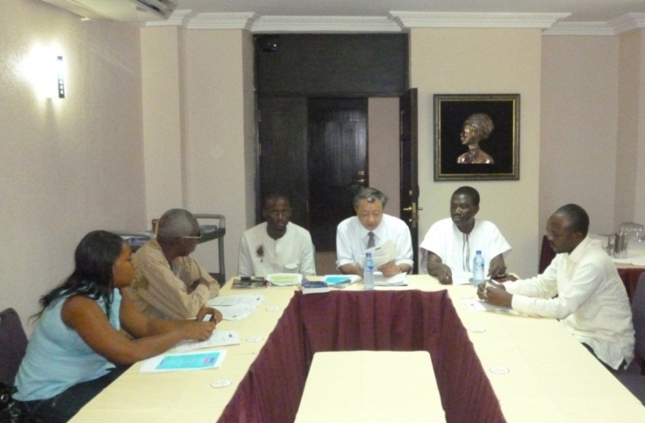
and the authority of the President System in Japan is the President, National Diet, and the Court. Pillars that support these authorities are international political parties like the World Party. The World Party was, aiming to be a political party that will exist even after 1000 years, founded based on these thoughts. This is written in also “World Party Declaration” adopted in the World Party Convention held in Ghana, Africa, in 2011. The World Party Convention is held once in four years. So, the Second World Party Convection will be held in 2015.
Present Situation of the World Federation Movement
At present, the biggest movement to establish the World Federation is WFM (World Federalist Movement) . This NGO has the headquarters in a building in front of the headquarters of the United Nation in New York. So far, WFM has been active mainly in the movement to establish the World Federation by evolving the United Nations. It has been playing a central role in the worldwide gathering of NGO called the “Hague Appeal ｆｏｒPeace” and in the foundation of the ICC (International Criminal Court). In Japan, there is WFM-Japan that is a chapter of WFM. WFM-Japan contributed in carrying the resolution of the National Diet that the establishment of the World Federation is the policy of state. There are some other organizations also.
On the other hand, the World Party is an international party composed of headquarters and branches, has branches in about 50 countries, and has about 140 members. It was founded in Japan in 1998 aiming to establish the World Federation. The headquarters is not incorporated and so it is a private group. The first policy is to found the World Parliament without the legislative power whose seats are in proportion to population of each country. If the Parliament functions well, it will be vested with the legislative power, will establish the world constitution, and will establish the World Federation. There is the World Government in the World Federation, and the World Government is concerned with only the limited aspects of society. Namely, in principle, it is concerned with only the administration of military forces, the issuance of currency, and other political and economic problems that individual country cannot solve alone. Other aspects of society such as religion, political and economic system like liberalism or communism, industry, agriculture, commerce, science, arts, sports, tradition, and so on are left free to each country. Therefore, in the World Federation, one country can declare the liberalism and another country can declare the communism. Furthermore, religion is recognized as a private matter and so any religion is allowed in the World Party. Although World Party has a branch in each country, there is no exchange of official document between the headquarters and the branches. The relation between the headquarters and the braches is customary one. This is a measure to simplify the procedure when a branch is registered with the governmental office in each country.
At present, there is no World Federation and World Government. So, the World Party is aiming to establish the World Parliament without the legislative power like the European Parliament.
Source of Authority of
the World Party is International Cooperation
The World Party held the First World Party Convention in Ghana, Africa, in August in 2011. The photograph shows the World Party Convention. The Convention will be held once in four years, in 2015 and 2019. Major matters in the first Convention were that the World Party Statute and the World Party Declaration were adopted. We will be in action based on these Statute and Declaration. The source or the base of the authority of the World Party is the international cooperation.
The First World Party Convention
Ghana, Africa, August 2011
The World Party Japan is a branch of the World Party and has about 15 members. Relation between the World Party and the World Party Japan is a customary relation and, legally, documents and contracts are not exchanged. This is a measure to minimize legal problems that may emerge when branch in each country officially registers it with government office. A related organization World Government Institute is writing “A Draft of World Parliament Statue” and “A Draft of Constitution of World Federation”. Theses have not been completed yet but basic thought is written and these are published on the Internet. The World Government Institute Japan has mostly completed “A Draft of New Constitution of Japan”, and this is published on the Internet.

Slide 6
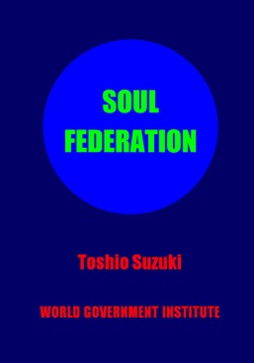
Policy of the World Party Japan Is Composed of International Policy and Domestic Policy.
ＩＮＴＥＲＮＡＴＩＯＮＡＬ POLICY
Respect for the United Nations
The Mahatma Gandhi Initiative
Establishment of the World Parliament, the World Federation, and the World Government
DOMESTIC POLICY
Abolition of the Emperor System and Introduction of the President System
Reconstruction of Finance
International Policy
Respect for the United Nations
As we can see from the bombing on Afghanistan after terrorist attack in USA in 2001 and invasion of Iraq in 2003 by USA, the most powerful country USA does not respect the United Nations. It can be said that the respect for the United Nations is the first step toward the world democracy. With great power comes great responsibility. If the most powerful country in the world respects the United Nations, other countries cannot ignore it. Invading other countries without the decision of United Nations is a heavy crime.
The Mahatma Gandhi Initiative
Mahatma Gandhi led India to the independence by the policy of Non-Violence & Disobedience. This policy is applicable to the present world affairs. Countries where there are organizations committing international terrorism are invaded by foreign countries. Countries of democracy, for example India, are not invaded. This policy was named, with respect for Mahatma Gandhi, "Mahatma Gandhi Initiative“, and was designated as one of the policies of World Party Japan.
Establishment of the World Parliament, the World Federation, and the World Government
The World Party in each country, emphasizing its main policy, fights the election. If the World Party Japan gets the power, it will enact a law for the election of the World Parliament member, conduct the election , and send delegates to the World Parliament in proportion to population. Elected delegates of each country, even if the election was conducted in only 2 countries, can form a part of the World Parliament. Other countries can join later. Thus, from only a small part of the entire World Parliament, it can develop to the true World Parliament.
Domestic Policy
Abolition of the Emperor System, Introduction of the President System, and Reconstruction of Finance
The abolition of the Emperor System is necessary to prevent the militarism and to reconstruct the finance of Japan. Countries that does not respect the decision of the League of Nations or the United Nations and countries whose national finance go bankrupt cannot be called civilized countries. If we want to make Japan a civilized country, we must, first of all, abolish the Emperor System and introduce the President System. This is the necessity of history.
Contact to the World Party Headquarters and Related Organizations:
Address: 1-158 Nakakanasugi Matsudo City Chiba Prefecture, 270-0007, Japan
President: Toshio Suzuki
Website: www.w-g.jp
TEL: 090-5810-4373
E-mail: a@t-u.jp
Theoretical Basis of World Federation movement
Theoretical basis of World Federation movement that the World Party is promoting is written in a book Soul Federation.
Author: Toshio Suzuki.
Publisher: Xlibris .
You can order it to Amazon on the Internet or ordinary bookstore.
Soul Federation

