Slide 1
Presentation at
Third World Party Convention
President Toshio Suzuki
World Government Institute, World Party, World Citizen Network
http://www.w-g.jp/wp/conv-wp/presentations.htm
15 December 2019
I. Problems of Present World
1. War and Conflicts in Many Parts of World.
2. Poverty.
3. Destruction of Environment.
As far as war is concerned, what is the most responsible country in the world? I think that the worst evil in the politics of world is to invade or bomb other countries without the approval of United Nations.
For example, as shown in the Figure 1 below, USA and other countries attacked Iraq and Libya without the approval of United Nations, and the regime of Iraq and Libya was destroyed.
As a result, the Islamic State was born. If the most powerful country in the world respects the United Nations, other countries cannot ignore it.
Figure 1. Result of Ignoring the United Nations
Countries Such as USA, UK, France, etc. Invaded Iraq and Libya without Approval of United Nations and Destroyed Regime.
People Lost the Leaders and Islamic State was Born. North Korea does not want to become like Iraq and Libya, so they develop nuclear weapons.

Slide 2
So we need the authority stronger than the United Nations. Namely we need the World Parliament whose members are directly elected by people.
The problem of poverty is also important. Why does not the poverty disappear in the world with high technology? In a word, poor people are poor because they cannot get a job. The World Federation can provide jobs. It is shown in the Figure 2 below.
Figure 2. Reason Why the Poverty Is Not Eradicated
Free Competition and Private Ownership System, namely, Capitalism
Companies Employ People
Rate of Profit Falls
Marx’s Law of the Tendency of the Rate of Profit to Fall
Industrial Reserve Army
People Employed
For example, companies in Japan construct factories in developing countries such as Philippines, Thailand, Indonesia, etc. This is because the wage is low in developing countries. If people in developing countries are employed, their wage is lower than that of Japanese employees. But the income of employed people is much higher than people who are not employed. If we want to employ all the workers, we must make investment to enlarge company or found a new company. But profit is not sufficient for that policy. So, there emerge people who are not employed. They can be called the Industrial Reserve Army in Marxian Economics. This phenomenon is called the Marx‘s Law of the Tendency of the Rate of Profit to Fall. This phenomenon occurs if the world is under the system of free competition and private ownership. Then, how can we provide jobs to jobless people? We can provide jobs by running companies in the red. But, if companies are run in the red, the company loses the international competitive power and so the economy of country weakens. Soviet Union is an example. In former Soviet Union, people were employed following the plan of central government, and so economy became weaker. The Soviet Union collapsed in 1991. But, if many countries are in the World Federation, companies in the countries in the World Federation can run company in the red and provide jobs.

Slide 3
The theory of the Law of the Tendency of the Rate of Profit to Fall in Marxian Economics is applicable to the world as a whole. It is not applicable to each country. Namely, if we try to apply Marx’ theory to USA, Japan, UK, etc., it is not applicable. In these countries, the rate of profit does not fall and income per capita of laborer has been increasing. On the other hand, in developing countries, there is a phenomenon of the fall of rate of profit and the unemployed People who can be called the Industrial Reserve Army.
Around December 2018, thousands of people from South American countries gathered along the border between USA and Mexico. They wanted to go to USA because there is no job in their countries.
This phenomenon can be explained by Marx's theory. Namely they are Industrial Reserve Army. This thought is not the common sense in the present age. But, in the future, this thought will be a common a sense even among people who are not the expert in economics. For more detail, see the World Party Declaration.
2. Basic Benefits of World Federation.
1. World Federation can reduce or prevent the war. This will lead to the reduction in death and wound of people by war, in the destruction by war, and in the military expenditure.
2. World Federation can issue the international common currency. This will lead to the removal of fluctuation of exchange rate.
3. World Federation can provide employment to all the people. This will lead to the eradication of poverty.
Thus, there are some important benefits in the World Federation. It has been impossible to establish the World Federation. But there are some organizations dedicated to the establishment of World Federation. For example, there are following organizations.
For example, following organizations are working.
A. World Government institute, World Party, and World Citizen Network.
http://www.w-g.jp/
This is our group trying to establish the World Federation.
3. Present Situation of World Federation Movement.

Slide 4
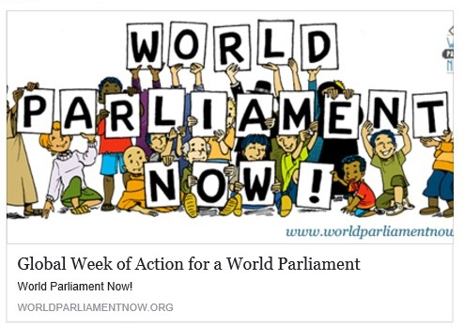
B. World Federalist Movement.
http://www.wfm-igp.org/
This group has played a very important role in the establishment of International Criminal Court.
C. World Parliament Now.
http://www.worldparliamentnow.org/
This group is promoting World Parliament. Mainly, They are working on the Facebook.
D. Campaign for a United Nations Parliamentary Assembly.
http://en.unpacampaign.org/
They advocate democratic representation of the world citizens at the United Nations. Recently, they published a book A World Parliament: Governance and Democracy in the 21st Century by Jo Leinen and Andreas Bummel.
E. World Parliament.
http://worldparliament-gov.org/
They wrote the “A Constitution for the Federation of Earth” and are promoting the ratification of it.
4. An Example of World Federation.
An example of World Federation is shown in the Figure 3. In the World Federation, the system is not the division of three powers, the legislation, the administration, and the judicature. The World Parliament is the supreme authority

Slide 5
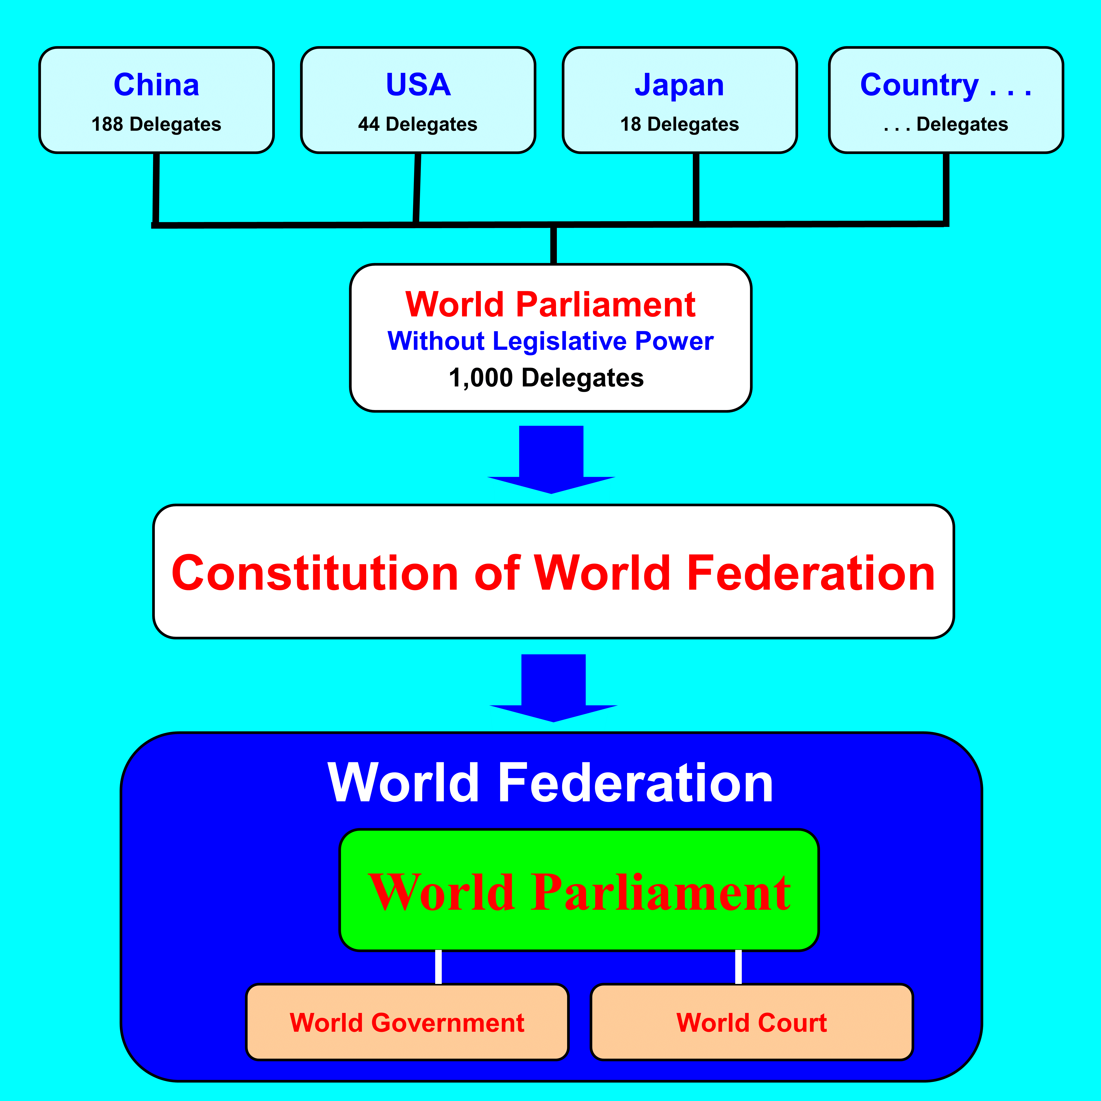
of the World Federation. The World Parliament elects the Prime Minister of the World Government and the judges of the World Court.
The World Parliament is composed of 1,000 members from each country. Delegates are sent from each country to the World Parliament in proportion to population. Even if only 2 countries send the delegates, it can form a part of the World Parliament and other countries can join later. Like this, a part of the World Parliament can develop to the whole World Parliament.
The World Parliaments on the early stage is a consultative assembly without the legislative power. If the World Parliament functions well, the legislative power is vested with by the attending countries, and the World Parliament establishes the Constitution of World Federation.
Figure 3. An Example of World Federation?
5. Removal of Inappropriate Members of World Parliament
Basically, members of World Parliament are 1,000. They can participate in the session of the Parliament.

Slide 6
On the other hand, each country can register members three times as many as its seats (Hereafter, this is mentioned as Registered Member.). For example, if the seats of a country are 10, the country can register 30 members. From among these 30 members, they can send 10 delegates.
The most important feature of this World Parliament is the system to remove inappropriate members that is shown in the Figure 4.
When a registered member demands the removal of another registered member, the registered member who demands the removal shall send a document of the demand with her or his name and clearly specified reason to the President of the World Parliament. The document shall be considered by the Board of Directors and shall be published on the website and in other publications of the World Party. If the demand of removal reach 10 percent of total number of votes of all the registered members, the Board of Directors shall send, by the name of the President, a notice to each registered member. In the next step, if each registered member objects to the removal of the member, she or he shall send the document of objection to the President. If this objections reach more than half of the votes of registered members within 1 year from the notice by the President, the registered member is not removed. Otherwise, the registered member shall be removed even if the demand for removal is 10% of the registered members.
Figure 4. Removal of Inappropriate Members
Registered Members Are 1,000
100 Registered Members Demand the Removal of a Registered Member
If the objection to the removal is 500 or less, the Registered Member is Removed.
If the objection to the removal is 501 or more, the Registered Member is not Removed.

Slide 7
For example, suppose the registered members are 1,000, and 100 registered members demand the removal of a registered member. It is shown in the Figure 4. In this case, within 1 year from the notice, if 501 or more registered members object to the removal, she or he needs not be removed. If 500 or less registered members object to the removal, she or he shall be removed. So, a member may be removed even if the demand of removal come from only 10% of registered members. These process can be implemented through the Internet. Namely, removal of some members can be implemented without holding the World Parliament.
So, only 10 members may remain. But the remaining members will get the support of people in the world. So, this will make the World Parliament the supreme authority in the world politics.
6. We Need Love in the World
What is the fundamental cause of war? In a word, it is the lack of love. As written above, Islamic State was born after the death of leaders Saddam Hussein of Iraq and Muammar Gaddafi of Libya. They were attacked without the approval of United Nations. This policy was based on the imperialism of USA. Namely, USA wants to rule the world without respecting the United Nations.
So we need love in the world politics. How can we establish the politics with love in the world politics? First of all, we must recognize that no matter how the science develops, we must get old and die and there are woman and man in this world. So, if we want to be happy, we must build a healthy woman-man relation and have a healthy family relation. If we have this mind, we can have love in the world politics.
7. The Truly Good Thing Shall Become a Common Sense
It seems that there are two classes in this world. One class rules another class. For example, In USA, it is said that people whose income is top one percent get 20 % of income of country as a whole. As a result, there is a result of survey that only 8 people owns assets that are same as all the assets of the poorest 50% of all the people in the world. Thus, if this world is in the system of free competition and private ownership, assets are owned very unequally. So we need a thought that makes the world better. Namely, we need the concept of World Citizen. Basically, we should understand a philosophy that the truly good thing shall become a common sense . If we say something against a common sense we are laughed at.

Slide 8
For example, we are laughed at if we say that we should use kerosene lamp instead of electric light, we are laughed at if we say that we should ride cow or horse instead of motorcycle or car, we are laughed at if we say that Olympic Games and World Cup of Soccer should be abolished, we are laughed at if we say that the compulsory education should be abolished, etc. Thus the truly good thing shall become a common sense. So, the thought of World Citizen and the World Federation shall become a common sense in the future.
Flags of Branches of World Party
World Party World Party Bangladesh
World Party Japan
World Party India
Logo of World Party has been registered with Japan Patent Office. Dark blue of background means the universe. Blue circle means the earth. Green circle means the life on the earth. World Party Bangladesh was founded on 31 October 2018, and Mr. Md Mahmudul Hasan became the First President of World Party Bangladesh. World Party India was founded on 15 August 2019. Dr. Lalit Kumar became the First President of World Party India.
They may stand for the next election of Bangladeshi Parliament Indian Parliament.

Slide 9
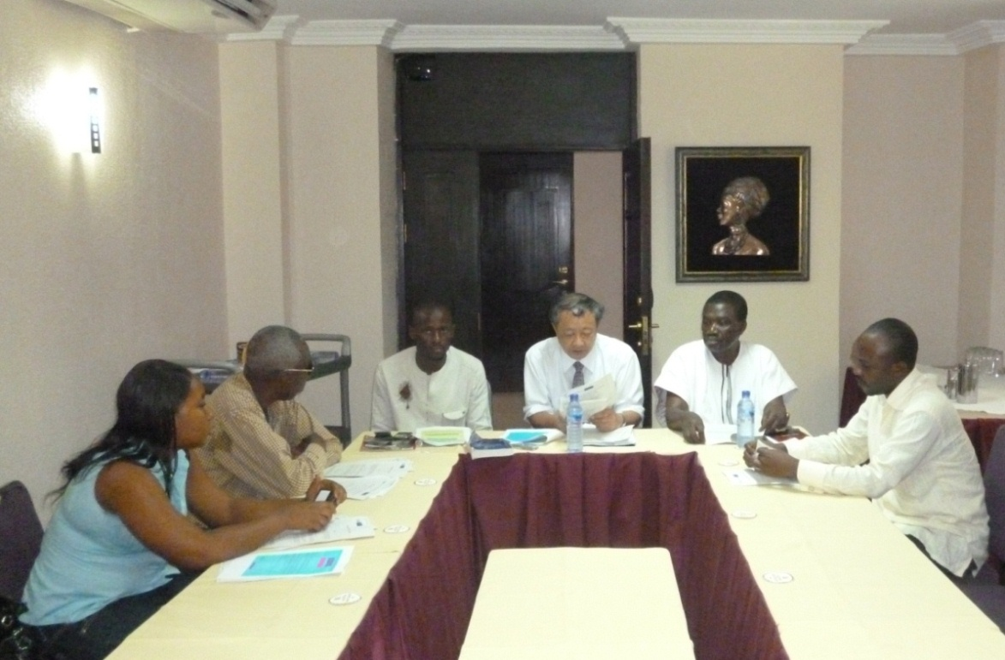
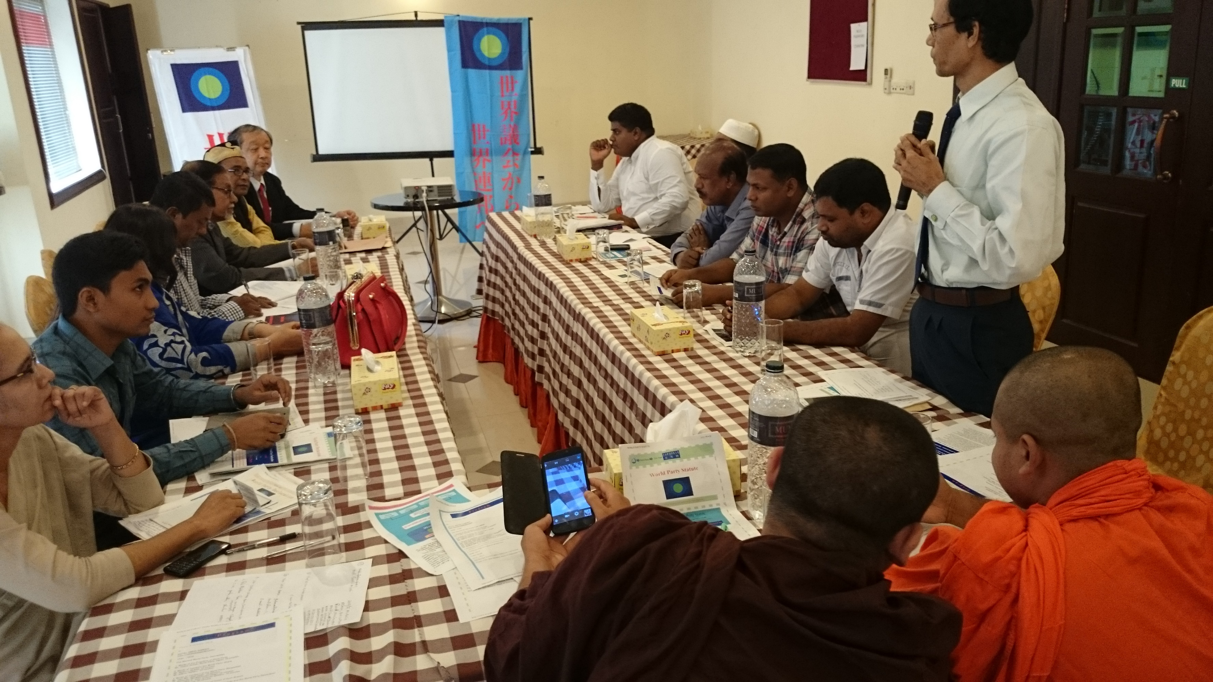
8. So Far, We Held Two World Party Conventions
The First World Party Convention Accra, Ghana,
12 August 2011
The Second World Party Convention Dhaka, Bangladesh,
9 October 2015
The Third World Party Convention is in Kathmandu, Nepal, on 15 December 2019. The most important object of the Convention is to adopt the World Party Declaration. In the Convention, seven Directors of World Party including me and some members are invited from Japan, Ghana, Bangladesh, and India.
Three Principles of World Party
1. The first priority is the benefits of world as a whole or the benefits of society as a whole. Benefits of party come after that. If the world becomes better, our country will become better. If our country becomes better, our life will become better.
2. There must not be lie with regard to the policy of World Party.
3. There must not be corruption in the World Party. We must be strict with regard to fund.

Slide 10
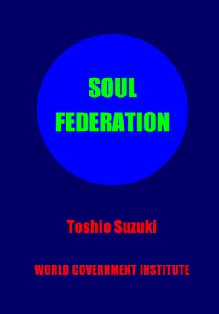
Contact to the World Party Headquarters and Related Organizations:
Address: 1-158 Nakakanasugi, Matsudo City, Chiba Prefecture, 270-0007, Japan
President: Toshio Suzuki
Website: www.w-g.jp
TEL: +81-90-5810-4373
E-mail: a@t-u.jp
Basic thought of
President of World Party
My lifeworks is the establishment of World Federation. If I am reincarnated into the next life and the World Federation has not been established yet, my lifework will be again the establishment of World Federation.
Soul Federation
Theoretical Basis of World Federation Movement
Theoretical basis of World Federation movement that the World Party is promoting is written in a book
Soul Federation.
Author: Toshio Suzuki.
Publisher: Xlibris .
You can order it to Amazon on the Internet or ordinary bookstore.
World Party was founded aiming to be
the party existing 1,000 years later.

